Slide 1
Project presentation
Topic name :- data analytics
By :- vinayak pawar.

Slide 2
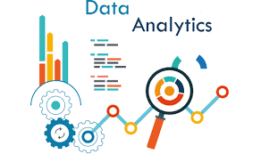
Introduction of data analytics
You will learn about the different types of data analysis and the key steps in a data analysis process. You will gain an understanding of the different components of a modern data ecosystem, and the role Data Engineers, Data Analysts, Data Scientists, Business Analysts, and Business Intelligence Analysts play in this ecosystem. You will also learn about the role, responsibilities, and skillsets required to be a Data Analyst, and what a typical day in the life of a Data Analyst looks like.

Slide 3
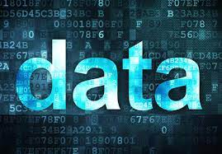
What is data
In Data analytics first we have to know the importance of data and how is it different from the information.
Data is a collection of facts, such as numbers, words, measurements, observations or even description of things. It may be in the form of text, images, audio, programs, or other types of data.
Data can be of a gigabyte, terabyte, petabyte or even more and this kind of data comes under the Big Data. It is measured, collected, reported and analyzed, whereupon it can be visualized using graphs, images or other analysis tools.
There are two types of data :-
1.Qualitative data is descriptive information (categorical i.e. non-numerical)
2. Quantitative data is numerical information (numerical)

Slide 4
difference of Data Analytics and Data Analysis : data analytics data analysis
1.It is described as a traditional form or generic form of analytics.
2.It includes several stages like the collection of data and then the inspection of business data is done
3.It supports decision making by analyzing enterprise data.
1.It is described as a particularized form of analytics.
2.To process data, firstly raw data is defined in a meaningful manner, then data cleaning and conversion are done to get meaningful information from raw data.
3. It supports decision making by analyzing enterprise data.

Slide 5
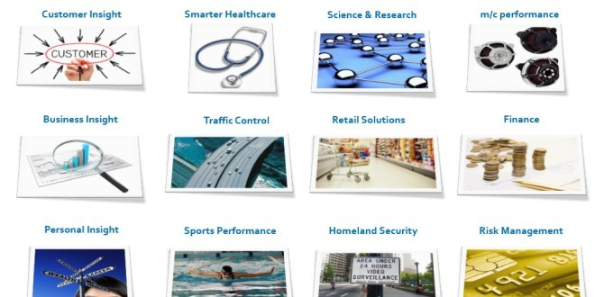
Data analytics applications Areas :-

Slide 6
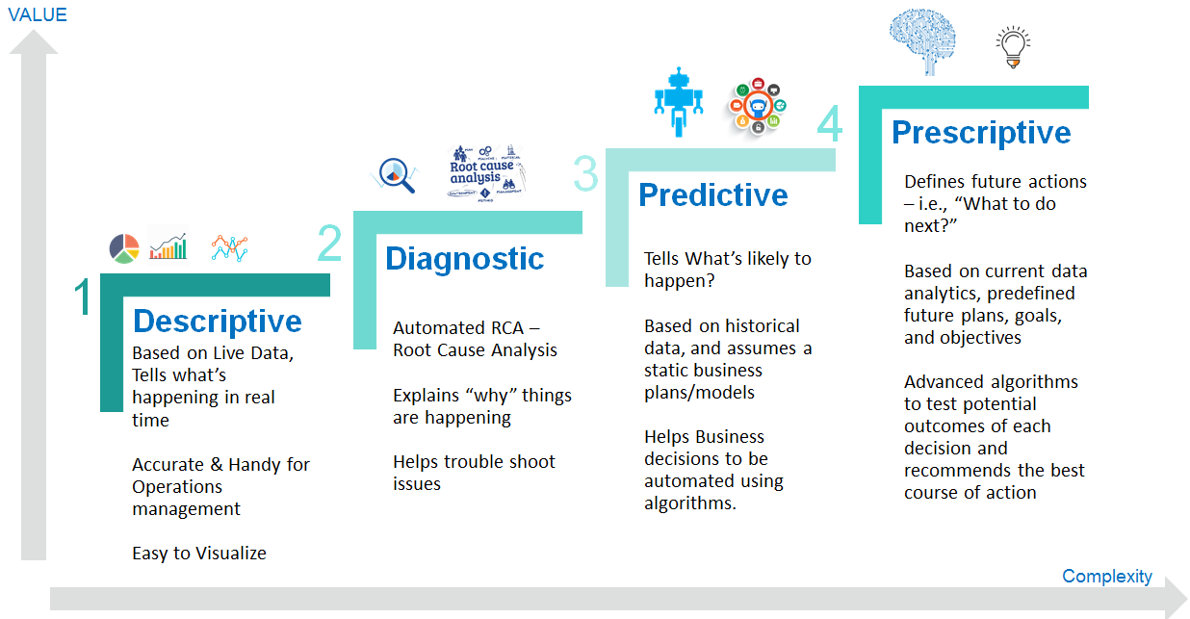
Types of data analytics :-

Slide 7
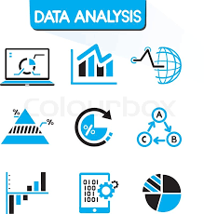
What is data analysis ?
Data analysis is a process of inspecting, cleansing, transforming, and modelling data with the goal of discovering useful information, informing conclusions, and supporting decision-making.[

Slide 8
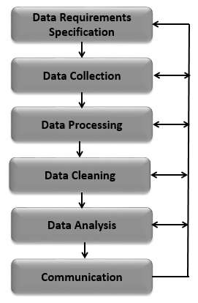
Data analysis process :-
Data Analysis is a process of collecting, transforming, cleaning, and modeling data with the goal of discovering the required information. The results so obtained are communicated, suggesting conclusions, and supporting decision-making. Data visualization is at times used to portray the data for the ease of discovering the useful patterns in the data. The terms Data Modeling and Data Analysis mean the same.

Slide 9
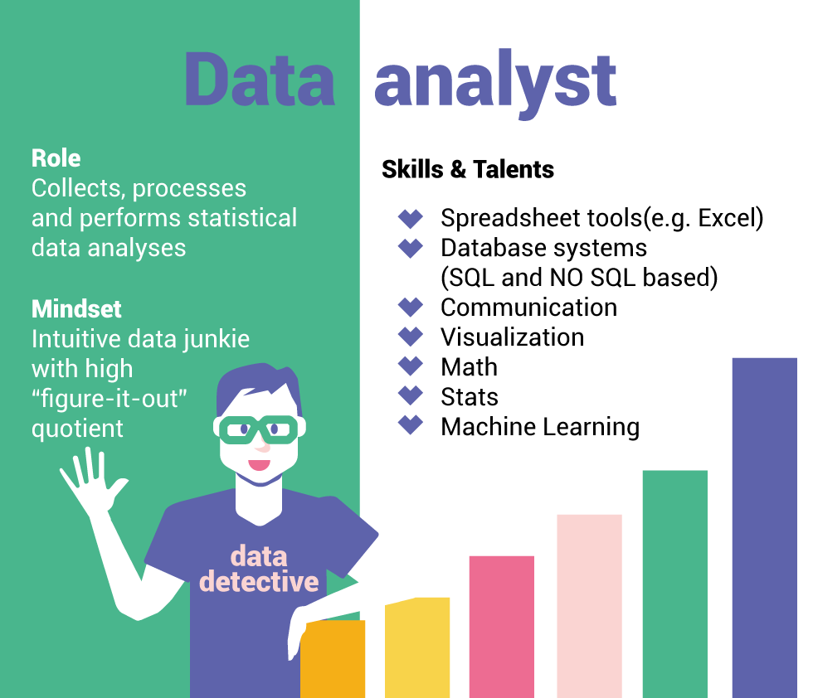
Role of data analyst:-
A data analyst collects and stores data on sales numbers, market research, logistics, linguistics, or other behaviors. They bring technical expertise to ensure the quality and accuracy of that data, then process, design, and present it in ways to help people, businesses, and organizations make better decisions.

Slide 10
!!! Thank you !!!

